Slide 1

Shantiniketan Educational Institutions Micolayout / Bilekahalli
Welcome to online learning
Subject –science (Biology)

Slide 2
Keep yourselves muted at all times except when your name is being called by the teacher.
Be prepared with the required stationary.
Using earphones is highly recommended.
You must be seated separately without any disturbance around you.
Please do not interrupt in between the classes.
The teacher has the authority to mute and even remove a student if he/she disturbs the class.
The last ten minutes of the session will be allotted for asking doubts.
Make sure that all your concepts are clear.
The students must have their camera “ON” throughout the session.
KEEP THESE INSTRUCTIONS IN MIND WHILE ATTENDING THE CLASS
HAPPY LEARNING!!

Slide 3
Choose your online learning space.
Make sure good lighting is available and the distance between you and the system is 20 inches apart.
Ensure that you sit on a comfortable chair so that the eyes look slightly down at the screen.
Have a water bottle available during the class.
Get familiar with the learning platform in advance.
Login early and check your network connection.
Ensure devices are fully charged.
Don’t treat this as an extended vacation.
Keep in touch with teachers through whatsapp group to clarify any doubts or to seek help.

Slide 4

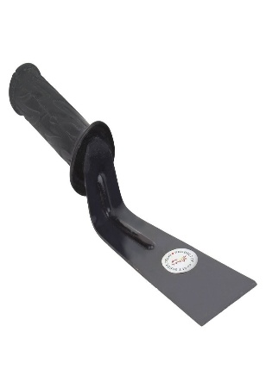
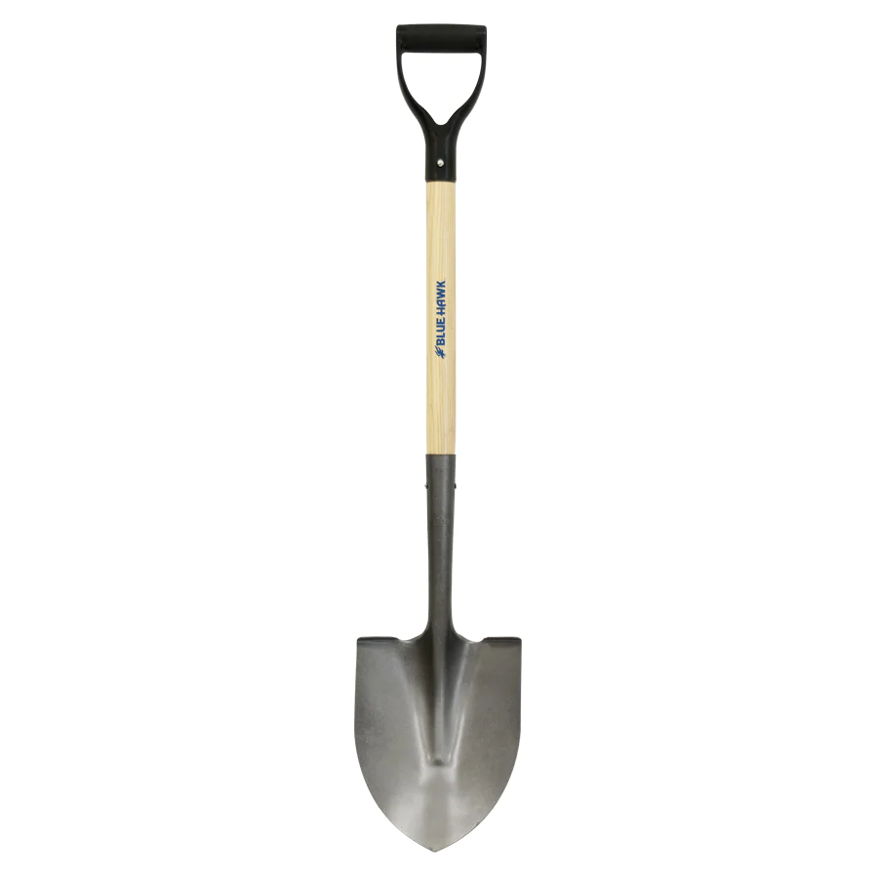
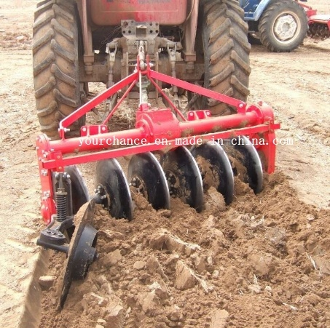
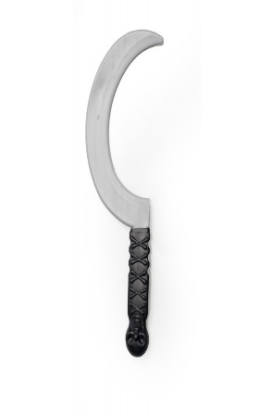
One day mythili and sparsh went to their grandmother’s house for summer vacation. Their grandfather is a farmer. One day they saw some tools like khurpi, sickle, shovel, plough. Etc… in the field.
i want to know where and how these tools are used.

Slide 5
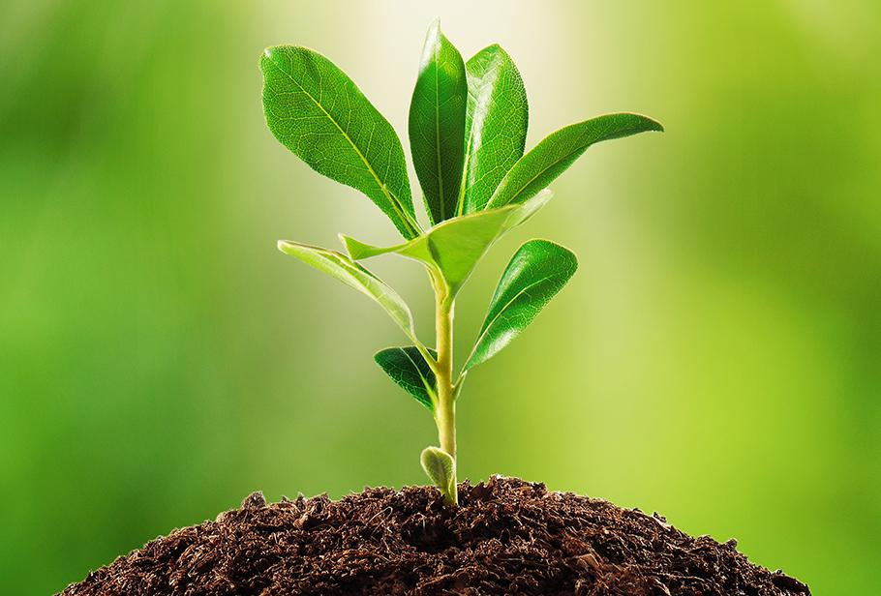
We all need food and from where does the food comes from?
Yes from plants . All organisms needs food.
We all know that plants prepare their own
Food . What is that mode of nutrition called?
Including humans cannot prepare their own
food .
Why do we need food?
Yes, to get energy and this energy is utilized
by us for different life sustaining activities .

Slide 6
Since we all need food how can we provide the food to large number of people in our country
Food has to be produced in large scale .
In order to provide food for large population-regular production , proper management, and distribution is necessary.
How can that be achieved?
So that can be done by……

Slide 7
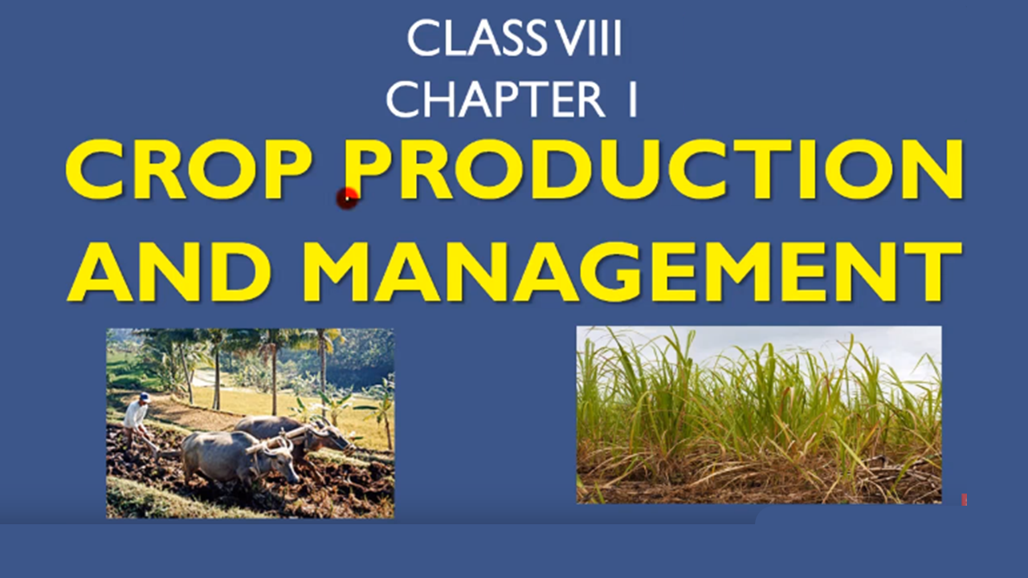

Slide 8
contents:
Agricultural practices
Agricultural implements
Sowing of seeds
Fertilizers and manure
Irrigation traditional method of irrigation.
Modern method of irrigation
Weeds
Harvesting
Storage
Foods from animals

Slide 9
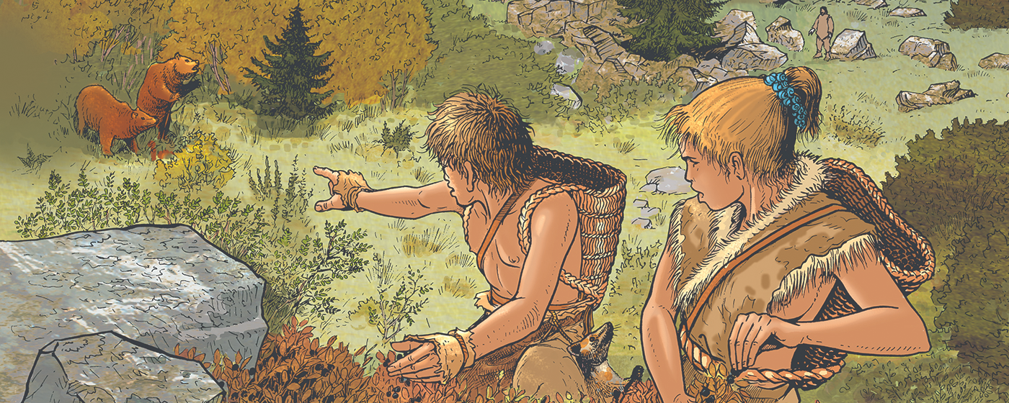
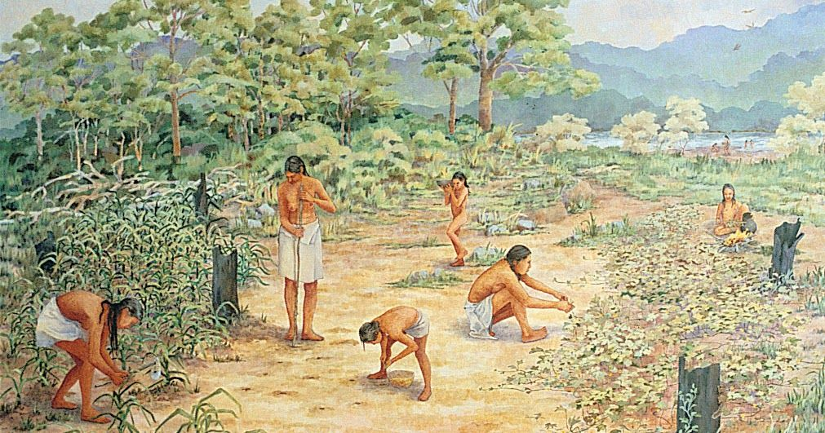
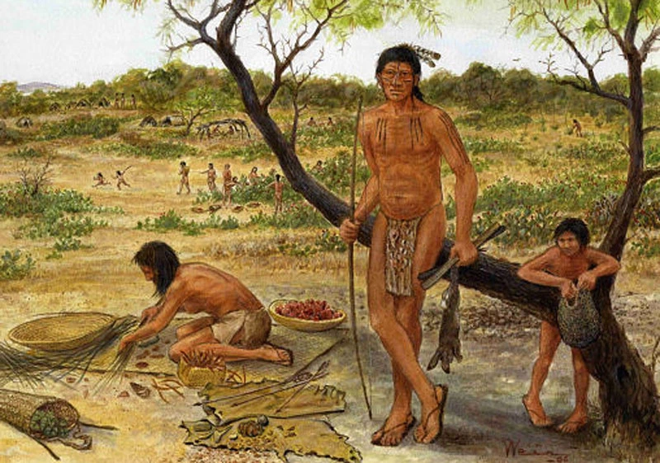
Till 10,000 B.C.E people were nomads they were moving from one place to another in search of food and water. They ate raw fruits and vegetables and hunt the animals.
Later they could cultivate the land to produce rice, wheat, and other food crops.
And thus, Agriculture was born .

Slide 10
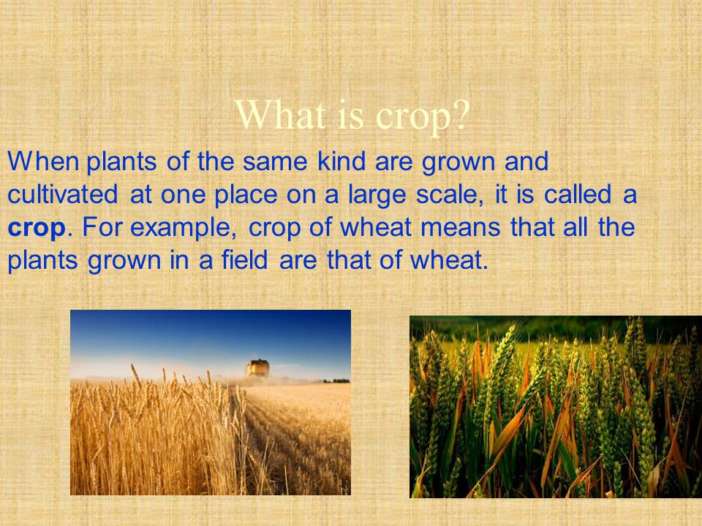
What is crop?

Slide 11
We all know that crops are of different types
Cereals
Pulses
Fruits
Vegetables etc..
They can be classified based on the season they grow.

Slide 12
India is a vast country . The climatic conditions like temperature, humidity , and rainfall vary from place to place . Accordingly variety of crops are grown in different parts of country.
Based on this two broad cropping patterns are observed.
Kharif crops
Rabi crops

Slide 13
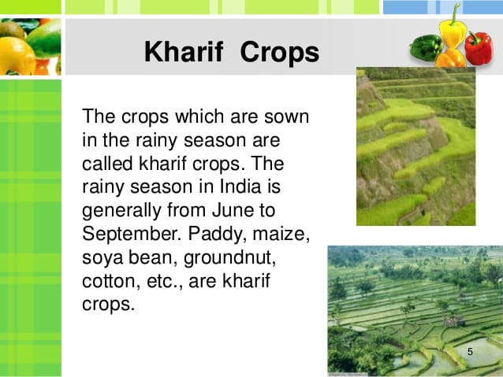

Slide 14
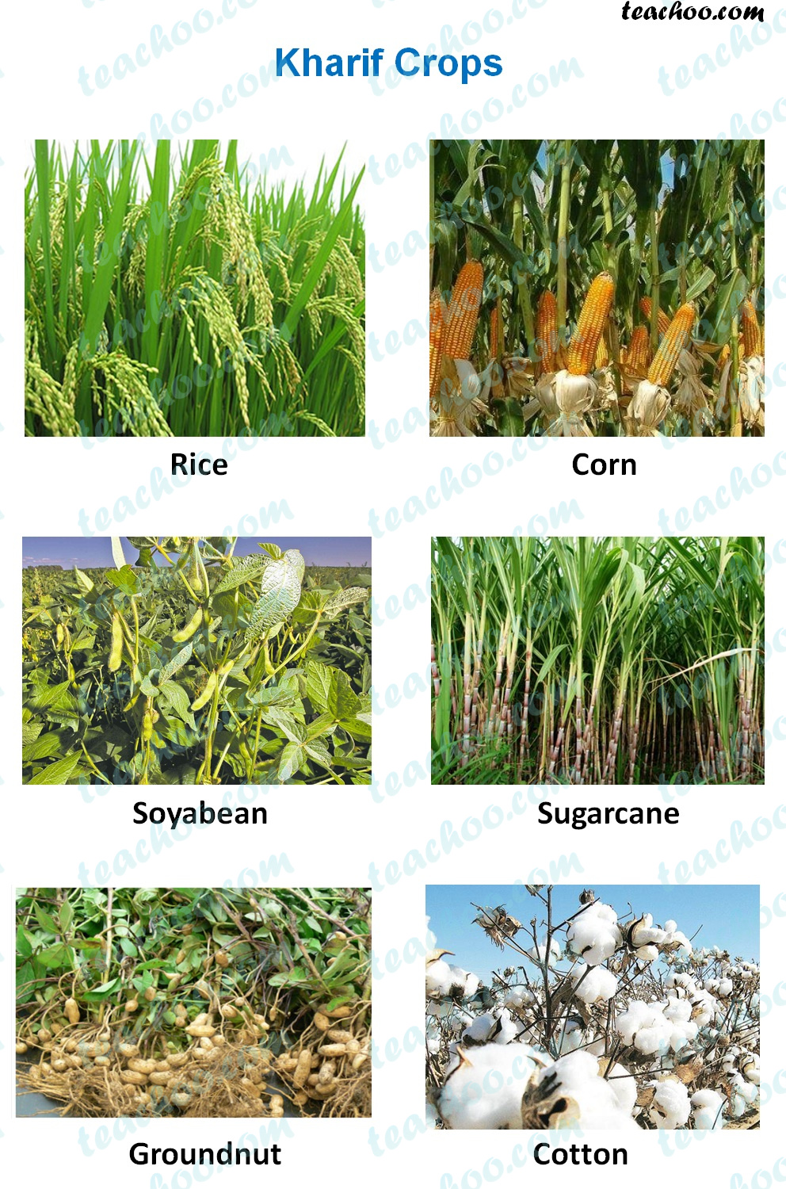
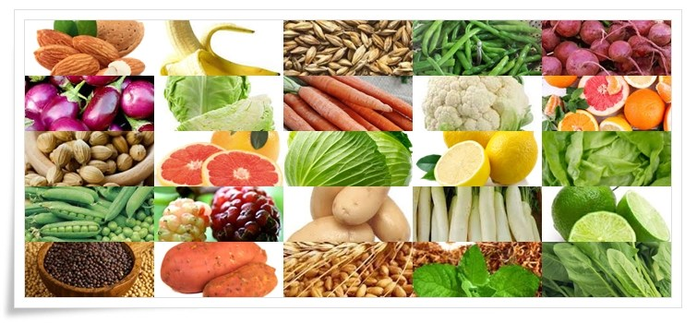

Slide 15
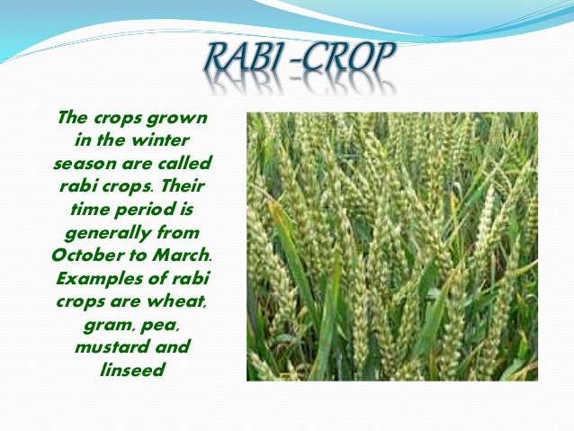

Slide 16
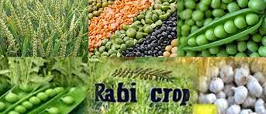
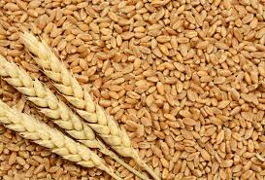

Slide 17
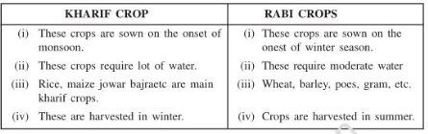
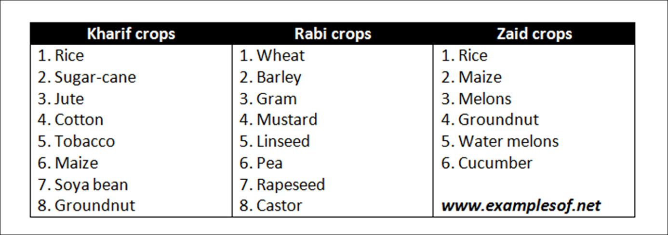

Slide 18

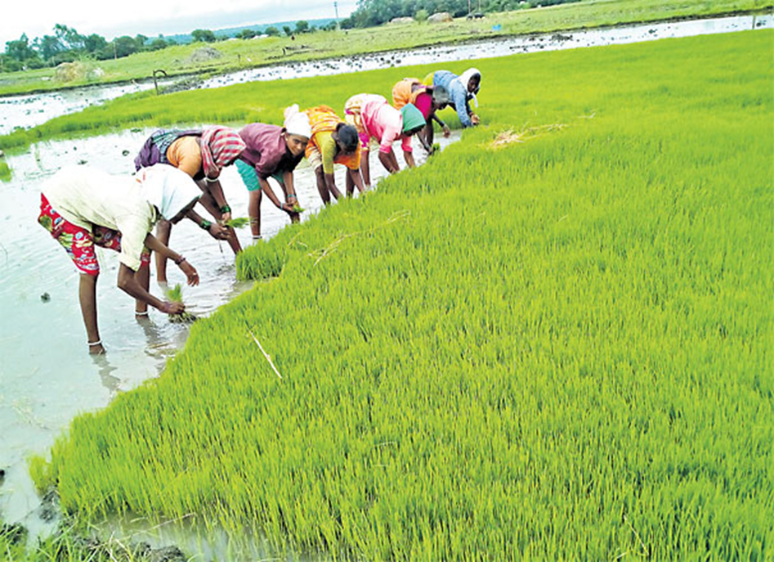
Did you know?
Why paddy cannot be grown in winter season?

Slide 19
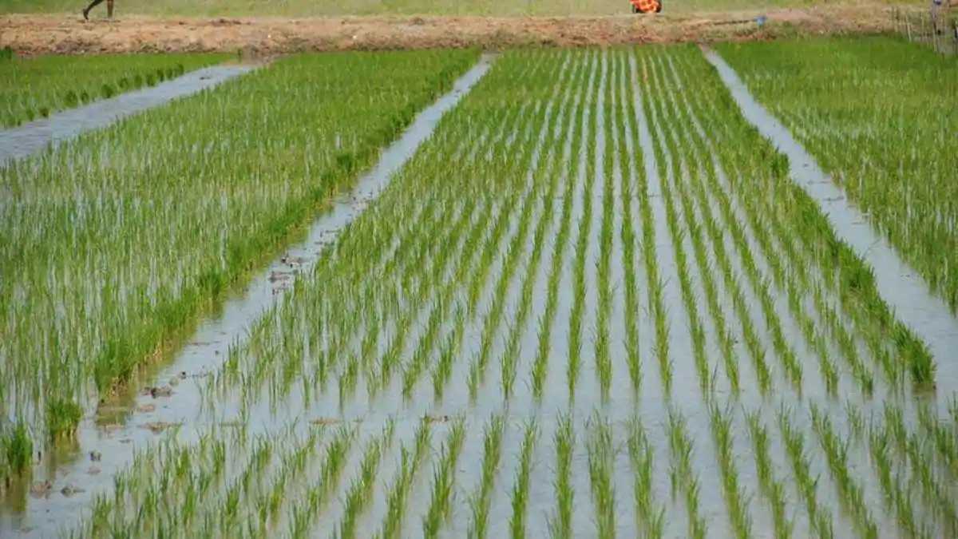
Paddy requires lot of water . Hence it is grown in rainy season.

Slide 20
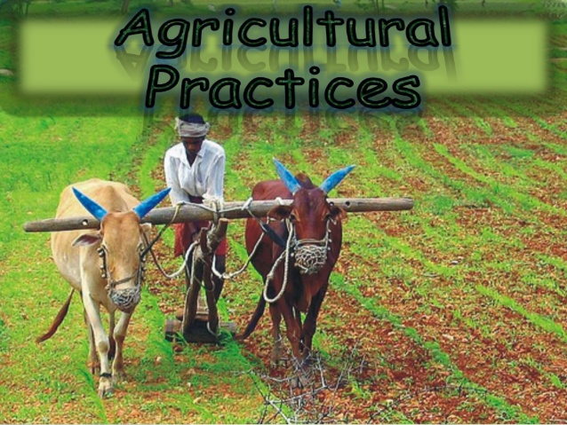
Cultivation of crops involves several activities undertaken by farmers over a period of time. You may find that these activities are similar to those carried out by a gardener or even by you when you grow ornamental plants in your house. These activities or tasks are referred to as

Slide 21
The agriculture practice are as follows;
Preparation of soil
Sowing
Adding manure and fertilizers
Irrigation
Protection from weeds
Harvesting
Storage

Slide 22
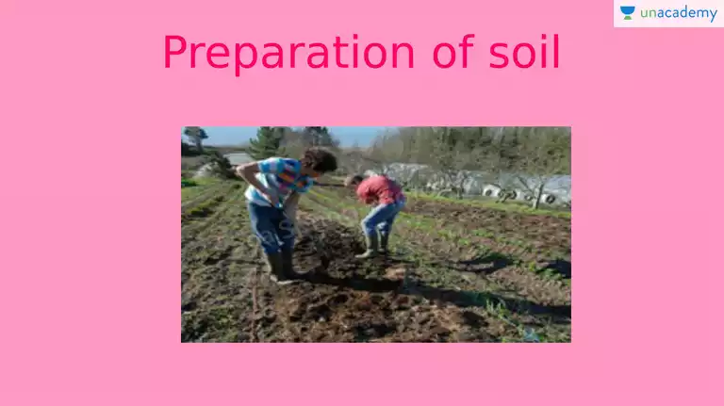

Slide 23
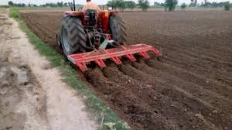
The preparation of soil is the first step before growing a crop.
One of the most important tasks in agriculture is to turn the soil and loosen it.
This allows the roots to penetrate deep into the soil.
The loose soil allows the roots to breathe easily even when they go deep into the soil.

Slide 24
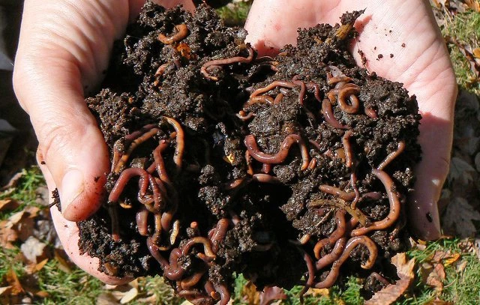
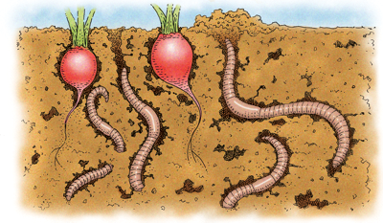
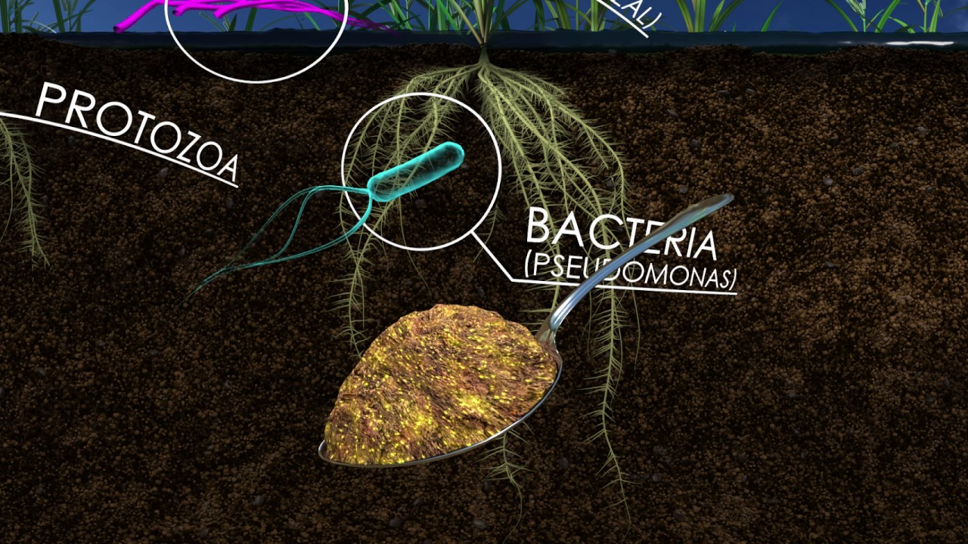
Why does the loosening of soil allow the roots to breathe easily?
The loosened soil helps in the growth of earthworms and microbes present in the soil. These organisms are friends of the farmer since they further turn and loosen the soil and add humus to it.

Slide 25
You have learnt in previous classes that soil contains minerals , water, air and some living organisms. In addition , dead plants and animals get decomposed by soil organisms are released back into the soil. These nutrients are again absorbed by plants.
Since only a few centimeters of the top layer of soil supports plant growth, turning and loosening of soil brings the nutrient-rich soil to the top so that plants can use these nutrients. Thus ,turning and loosening of soil is very important for cultivation of crops.

Slide 26
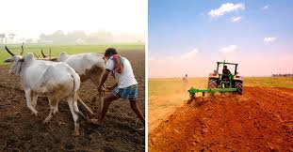
The process of loosening and turning of the soil is called TILLING or PLOUGHING. This is done by using a plough.
Ploughs are made of wood or iron.
If the soil is dry . It may need watering before ploughing.
The ploughed field may have big clumps of soil called crumbs. It is necessary to break the crumbs.
Levelling of field is beneficial for sowing as well as for irrigation. Levelling of soil is done with the help of a leveler.
Sometimes , manure is added to the soil before tilling. This helps in proper mixing of manure with soil. The soil is moistened before sowing.

Slide 27
AGRICULTURAL IMPLEMENTS
Before sowing the seeds, it is necessary to break the soil clumps to get better yield.
This is done with the help of various tools.
The main tools used for this purpose are:
Plough
Hoe
cultivator

Slide 28
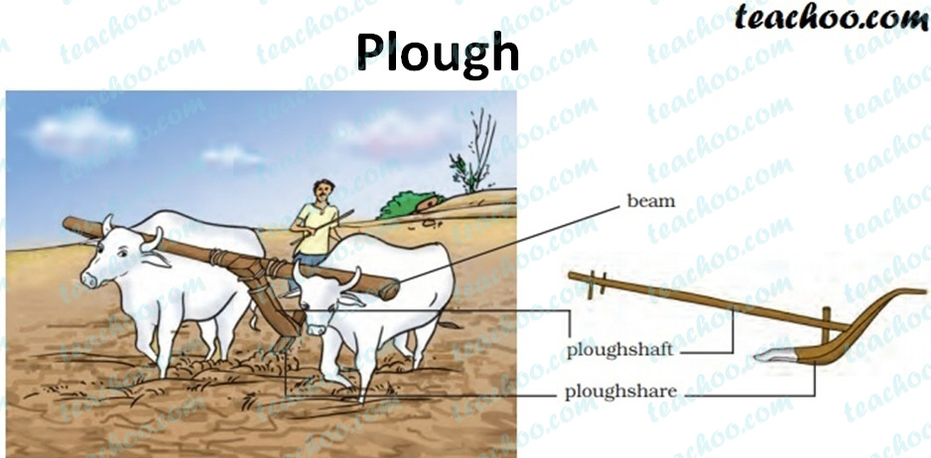
Plough
This is done from ancient times for tilling the soil, adding fertilizers to the crop , removing weeds and turning the soil.
This is made by wood and is drawn by the animals.
It contains a strong triangular iron strip called ploughshare.
The main part of the plough is long log of wood and is called plough shaft.
There is a handle at one end of the shaft. The other end is attached to the beam which is placed on the bulls neck.
A man can operate with the pair of bulls/camels/horse.
Wooden ploughs are nowadays replaced by iron plough.

Slide 29
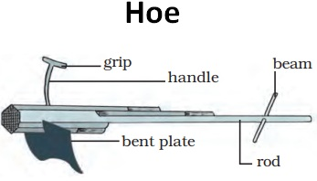
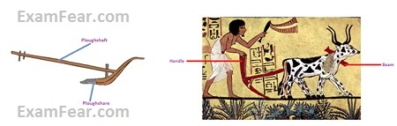
Hoe it is a very simple tool used to remove weeds and for loosening the soil. It has a long rod of wood or iron. A strong , broad bent plate of iron is fixed to one of its end and works like blade and is run by the animals.

Slide 30
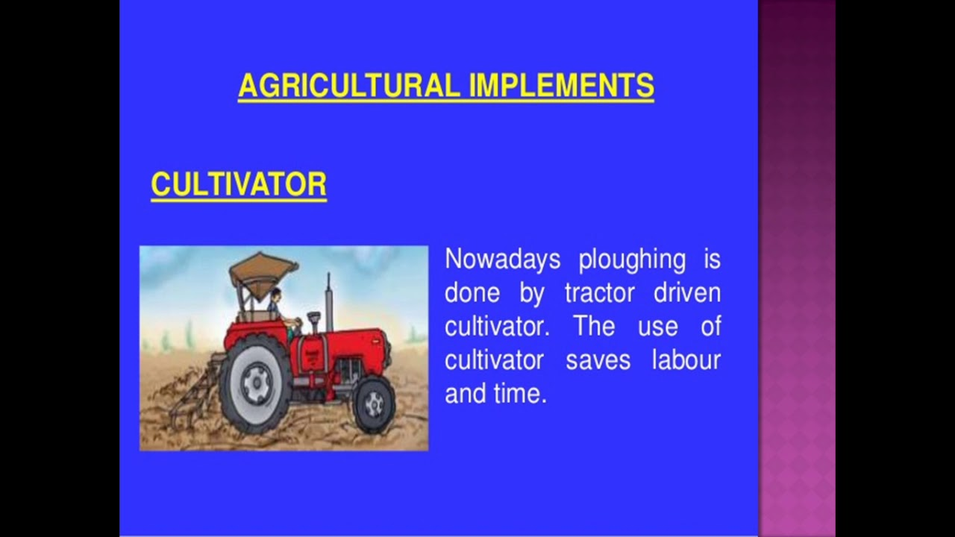

Slide 31
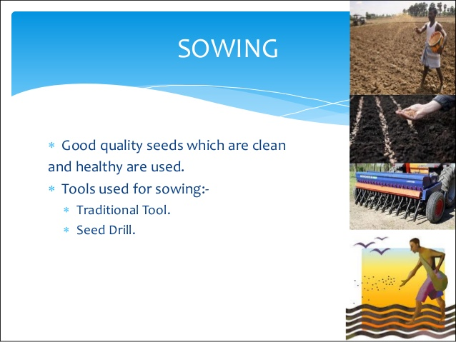

Slide 32


Slide 33
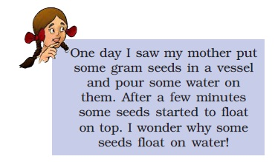

Slide 34

Are there seeds which float on water? Would those be lighter or heavier which float on water? Why would they be lighter?

Slide 35
Damaged seeds become hollow and thus are lighter. Therefore , they float on water.
This is good method for separating the healthy seeds from damaged ones.
Before sowing, one of the most important tasks is to know about the tools used for sowing seeds.

Slide 36
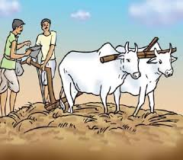
Traditional tools
The tool used traditionally for sowing seeds is shaped like funnel.
The seeds are filled in the funnel passed down through two or three pipes having Sharp ends.
These ends pierce into the soil and place the seeds into the soil .

Slide 37
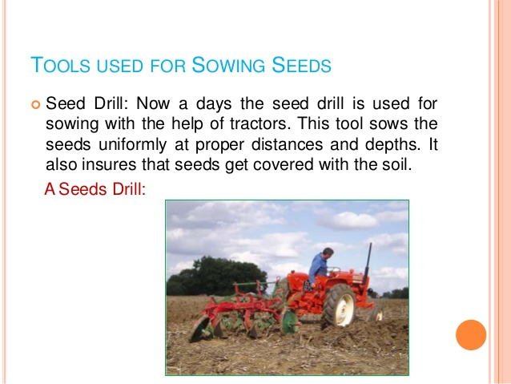
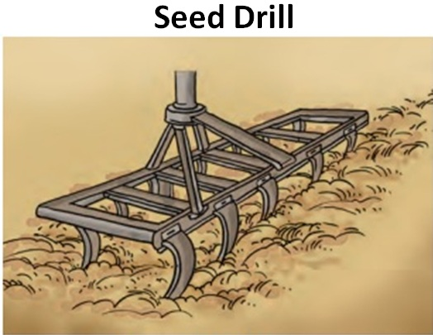

Slide 38
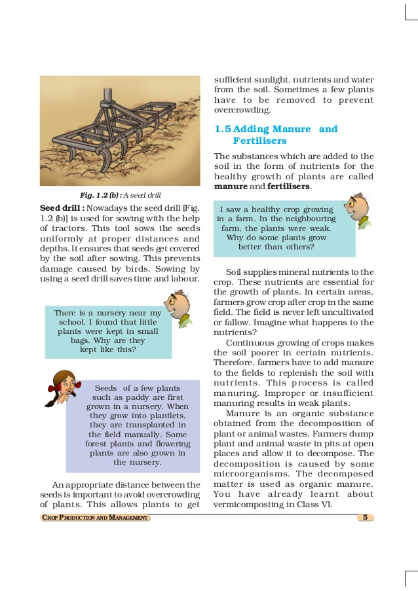

Slide 39
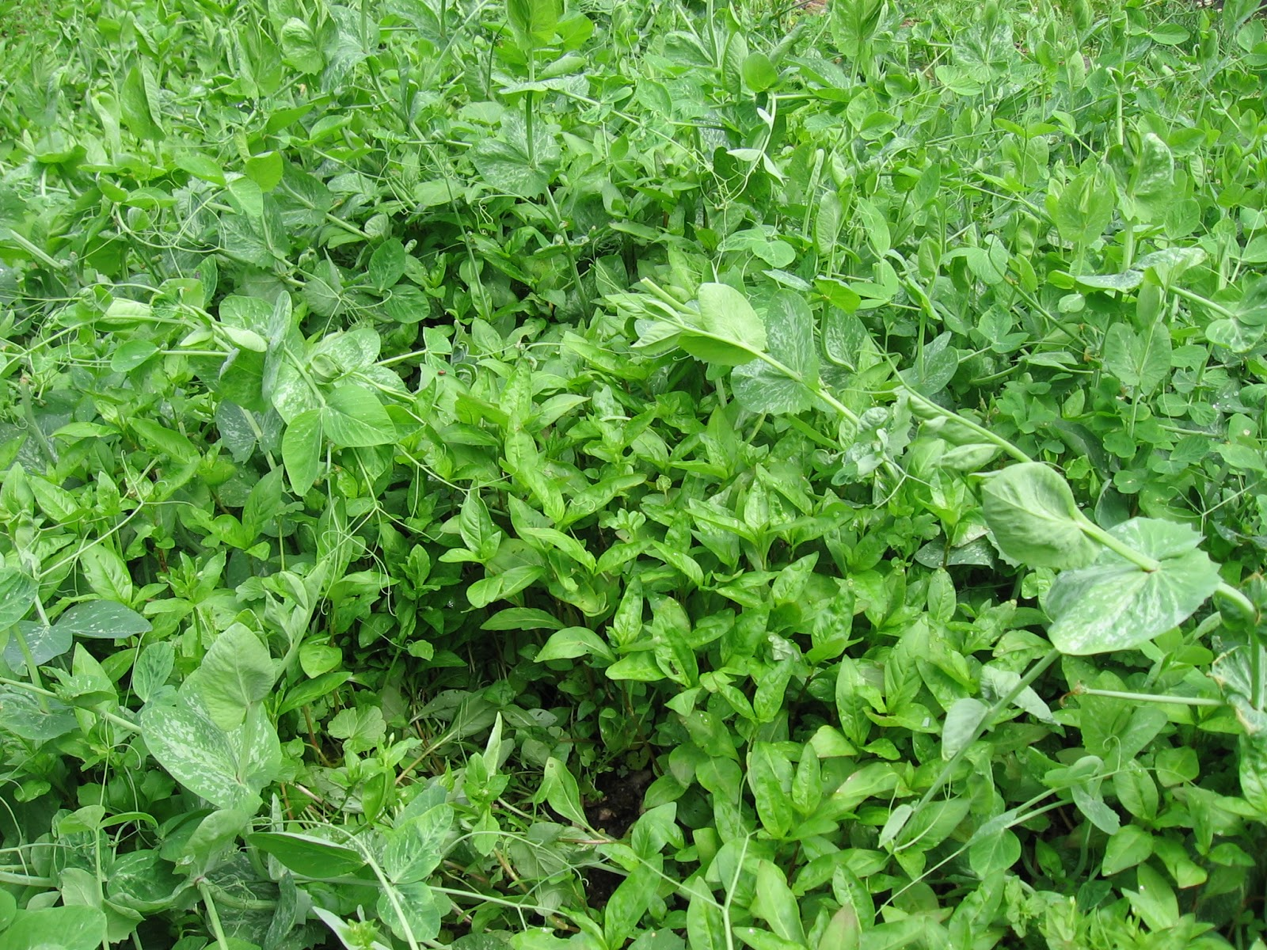
Appropriate distance between the seeds is necessary to avoid overcrowding of plants. This allows plants to get sufficient sunlight, nutrients and water from the soil. At the times of plants may have to be removed to prevent overcrowding.

Slide 40
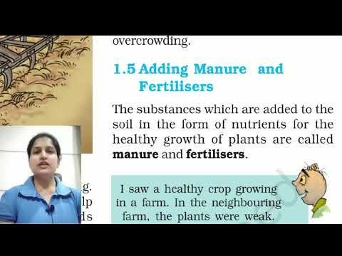

Slide 41

Why do some plants grow better than others?

Slide 42
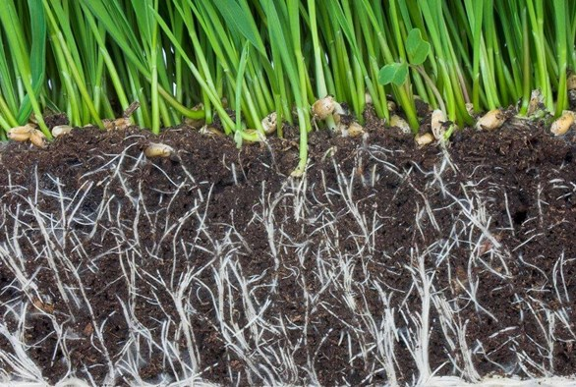
Soil supplies nutrients to the crops. These nutrients are useful for plants. In certain areas farmers cultivate the crops one after the other crop. Imagine what happens if this is done?
Continuous cultivation of crops makes the soil poor in nutrients. Therefore farmers have to add manure to the field to replenish the nutrients in the soil.
This process is called manuring.
Improper and insufficient manuring results in weak plants.

Slide 43
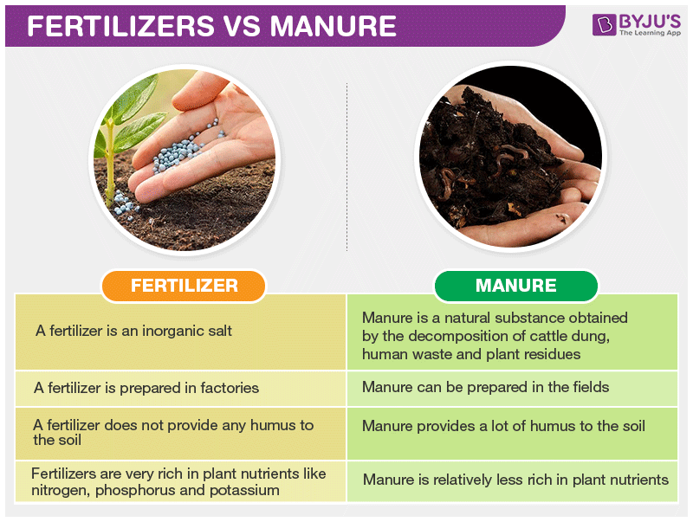

Slide 44
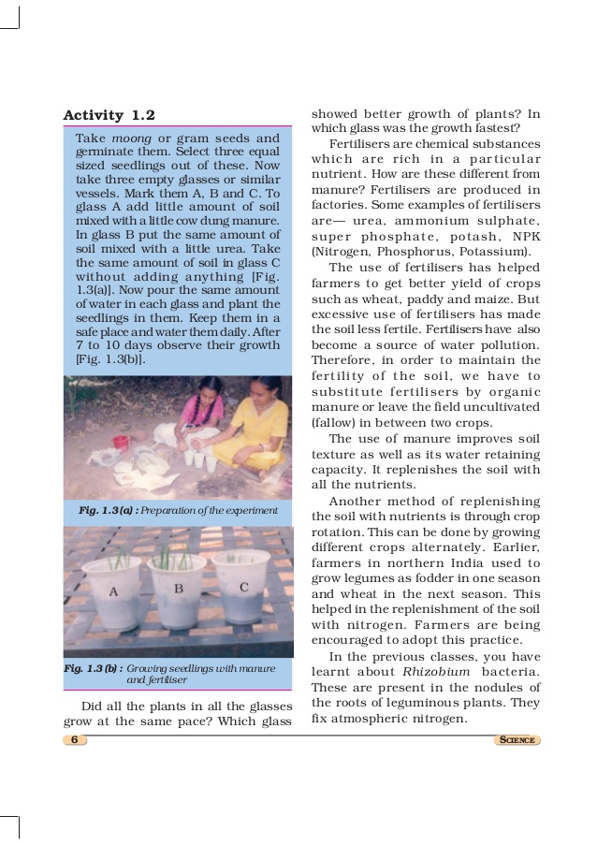
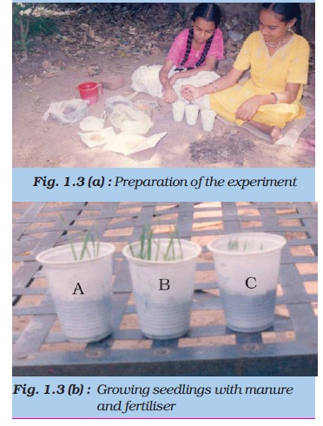

Slide 45
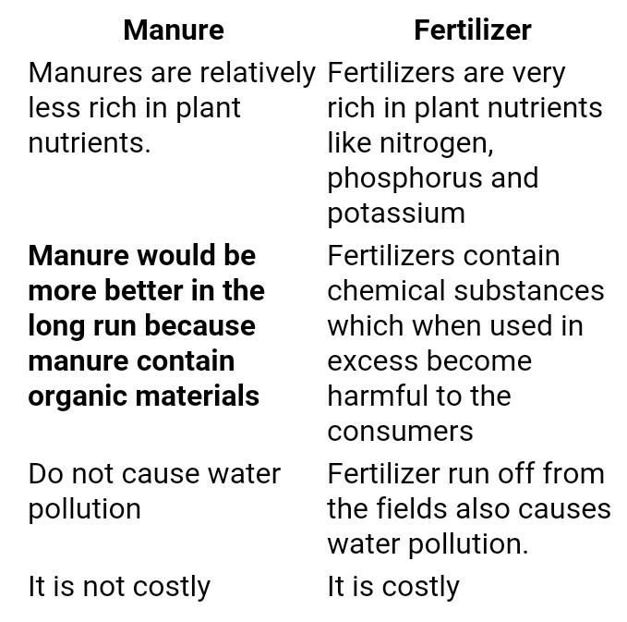

Slide 46
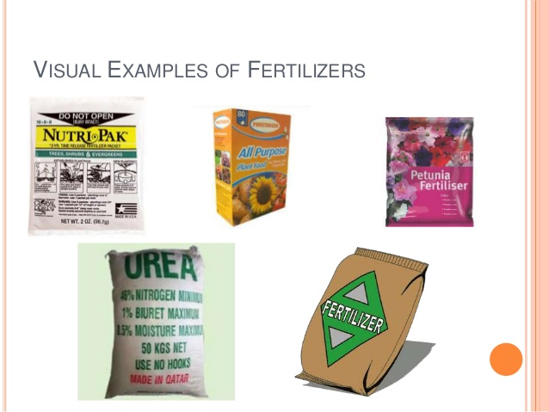
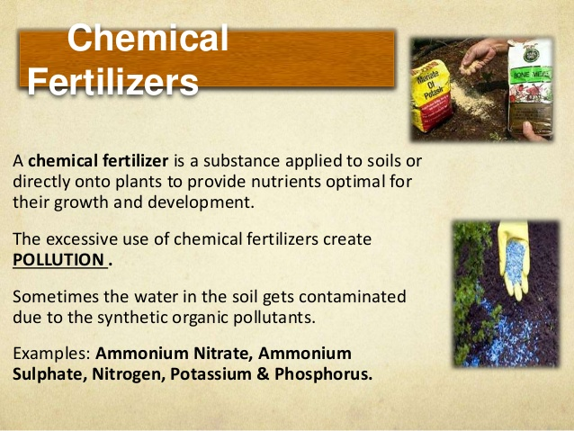

Slide 47
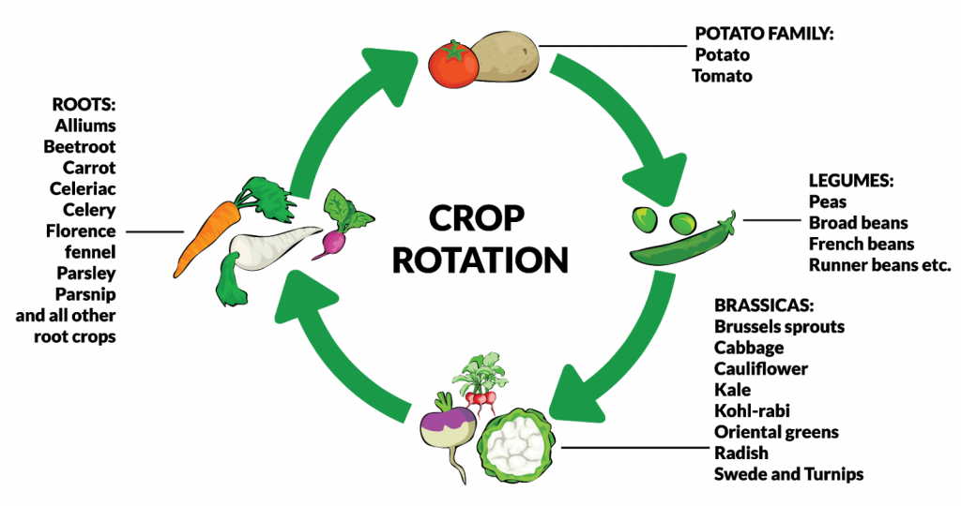
we have to use fertilizers in a right way excessive use of this can damage the quality of soil. Hence we use more organic manure.
Another way to replenish the nutrient in the soil is not to use the land for some period of time.
And also we can follow crop rotation.
This can be done by growing different crops alternatively.

Slide 48
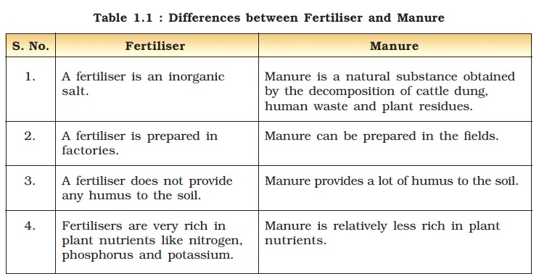

Slide 49
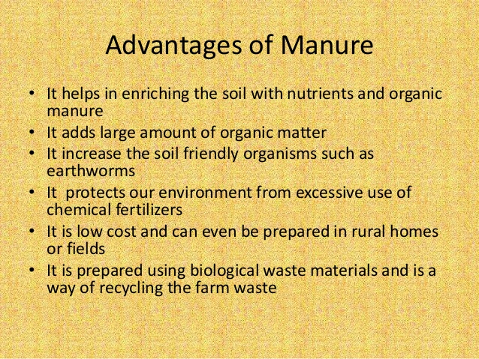

Slide 50
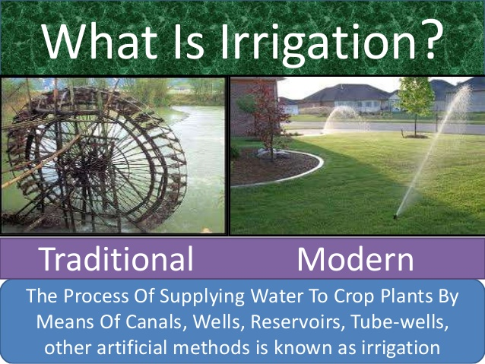

Slide 51
Sources of irrigation are wells, tube wells, rivers, lakes, dams, canals , ponds.

Slide 52

Traditional method of irrigation

Slide 53


Slide 54


Slide 55


Slide 56



Slide 57




Slide 58


Slide 59



Slide 60


Slide 61


Threshing:
Threshing is the process of separation of grain from the stalk on which it develops and from the chaff or unit that covers it. In the process, the edible part of the crop is loosened but not the fiber part. It is done after harvesting and before winnowing. The technique that was used in old times was striking the harvested ears of grain with a thrash and this or bulls trod out the grain from stalks. was done manually. Alternatively, horses, donkeys

Slide 62


Threshing can be carried out by machine called combine . This is in fact act both as harvester as well as thresher.

Slide 63


Slide 64



Slide 65


Slide 66
Harvest Festivals Of India Calendar
Here is the list of harvest festivals of India with dates on which they are celebrated. Take a look!
Festival Date (2020)
Makar Sankranti 15th January
Baisakhi 13th April
Ladakh Harvest Festival Yet to be announced
Lohri 13th January
Basant Panchami 29th January
Bhogali Bihu 16th January
Wangala 2nd week of November
Ka Pomblang Nongkrem 2nd or 3rd week of November
Nuakhai 23rd August
Gudi Padwa 25th March
Nabanna Yet to be announced
Onam 22nd August – 2nd September
Pongal 15th January – 18th January
Ugadi 25th March
Vishu 14th April
Agera 4th October
Dree Festival 5th July

Slide 67


Slide 68



Slide 69

Food
from
animals

Slide 70




Slide 71


Slide 72

Recapitulation

Slide 73


